Slide 1
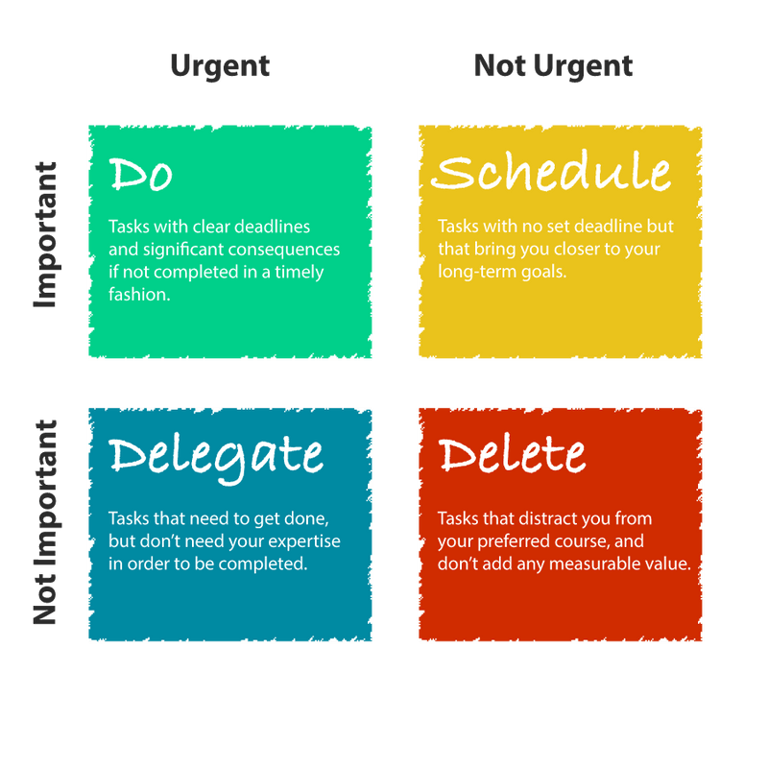
Draw the Urgent Important matrix

Slide 2
Name your goal within one year. Name three sub-goals that will allow you to achieve your primary goal:
GOAL:
Acquire more skills for success.
SUB-GOALS:
Focus on the things you can change
Take baby steps
Don’t tackle everything at once

